Slide 1


SIMATS ENGINEERING
SAVEETHA INSTITUTE OF MEDICAL AND TECHNICAL SCIENCES
Development of a Smart Stock Market Trend Prediction and Financial Analytics Dashboard Using Time Series Analysis
DSA0404 – Fundamentals of Data Science
Date :4/9/2026 Batch :10
Guided by:
Dr. Krishnaraj Mony
Associate Professor/CSE
Presented by:
Sk. Nuha-192472242
T. Chandana -192472059
U.Midhula -192472115

Slide 2


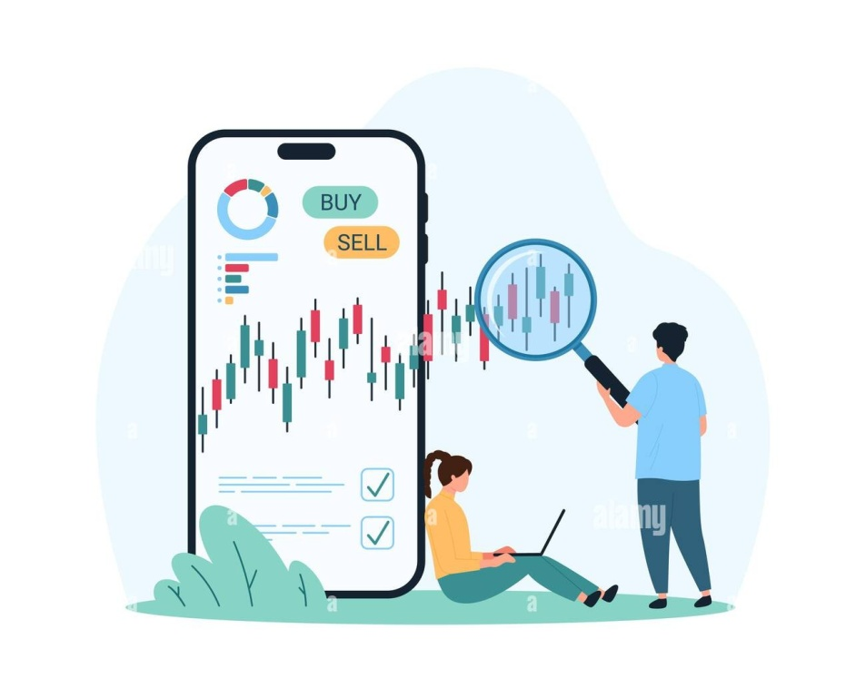
INTRODUCTION
The stock market generates large volumes of historical and real-time financial data that contain valuable trends and patterns.
Predicting future stock prices manually is difficult due to market volatility, economic events, and investor behavior.
Traditional forecasting techniques often fail to capture complex time-dependent relationships in financial data.
This project develops a smart stock market prediction system using Time Series Analysis and Machine Learning techniques.
The system provides accurate trend prediction and an interactive financial analytics dashboard to support investment decision-making.

Slide 3
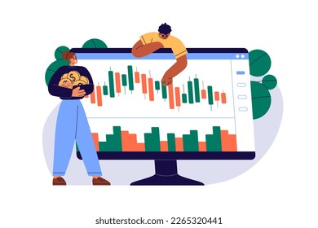
OBJECTIVES
Stock Market Data Collection: Collect historical stock market data including Open, High, Low, Close, Volume, and Trading Date.
Data Preprocessing: Clean missing values, remove inconsistencies, normalize data, and prepare datasets for forecasting.
Time Series Analysis: Analyze historical trends, seasonality, volatility, and market movements using time series techniques.
Stock Price Prediction: Develop predictive models using ARIMA, LSTM, Prophet, or Machine Learning algorithms to forecast future stock prices.
Financial Analytics Dashboard: Visualize stock trends, moving averages, predicted prices, and investment insights through an interactive dashboard.

Slide 4
LITERATURE SURVEY
S.No | Title | Authors | Year | Techniques Used | Problem Addressed
1 | Stock Price Prediction Using LSTM Networks | S. Hochreiter et al. | 2024 | LSTM Deep Learning | Low accuracy in long-term stock prediction
2 | Financial Time Series Forecasting Using ARIMA Models | J. Box, G. Jenkins | 2024 | ARIMA | Difficulty in forecasting market trends
3 | Hybrid Machine Learning for Stock Market Prediction | Y. Zhang et al. | 2025 | Random Forest + XGBoost | Handling complex financial datasets
4 | Deep Learning-Based Financial Forecasting | A. Kumar, P. Sharma | 2025 | CNN-LSTM | High volatility in stock prices
5 | Stock Trend Prediction Using Prophet Model | M. Taylor, B. Letham | 2025 | Facebook Prophet | Seasonal pattern forecasting

Slide 5
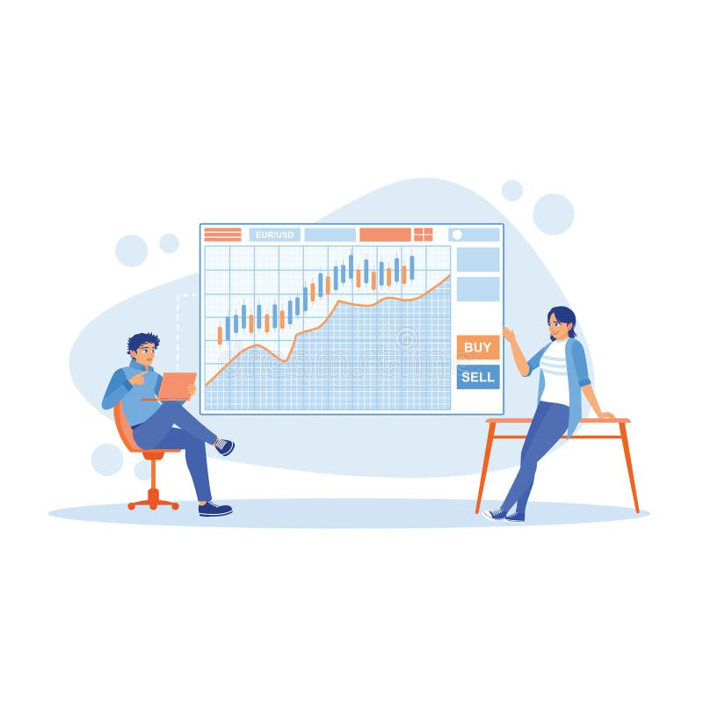
EXISTING SYSTEM
Traditional stock market analysis mainly depends on manual chart observation and expert interpretation.
Conventional forecasting methods provide limited accuracy in rapidly changing market conditions.
Existing systems struggle to handle large-scale financial datasets efficiently.
Many prediction models fail to capture seasonal trends and market volatility.
Most traditional approaches lack interactive visualization and intelligent financial analytics.

Slide 6

PROPOSED SYSTEM
Develop a Time Series-based stock market prediction system using historical financial data.
Implement Machine Learning and Deep Learning models for accurate stock price forecasting.
Perform trend analysis using moving averages, technical indicators, and statistical methods.
Build an interactive Financial Analytics Dashboard displaying real-time trends, predictions, and performance metrics.
Provide investors with reliable insights to support data-driven investment decisions.

Slide 7
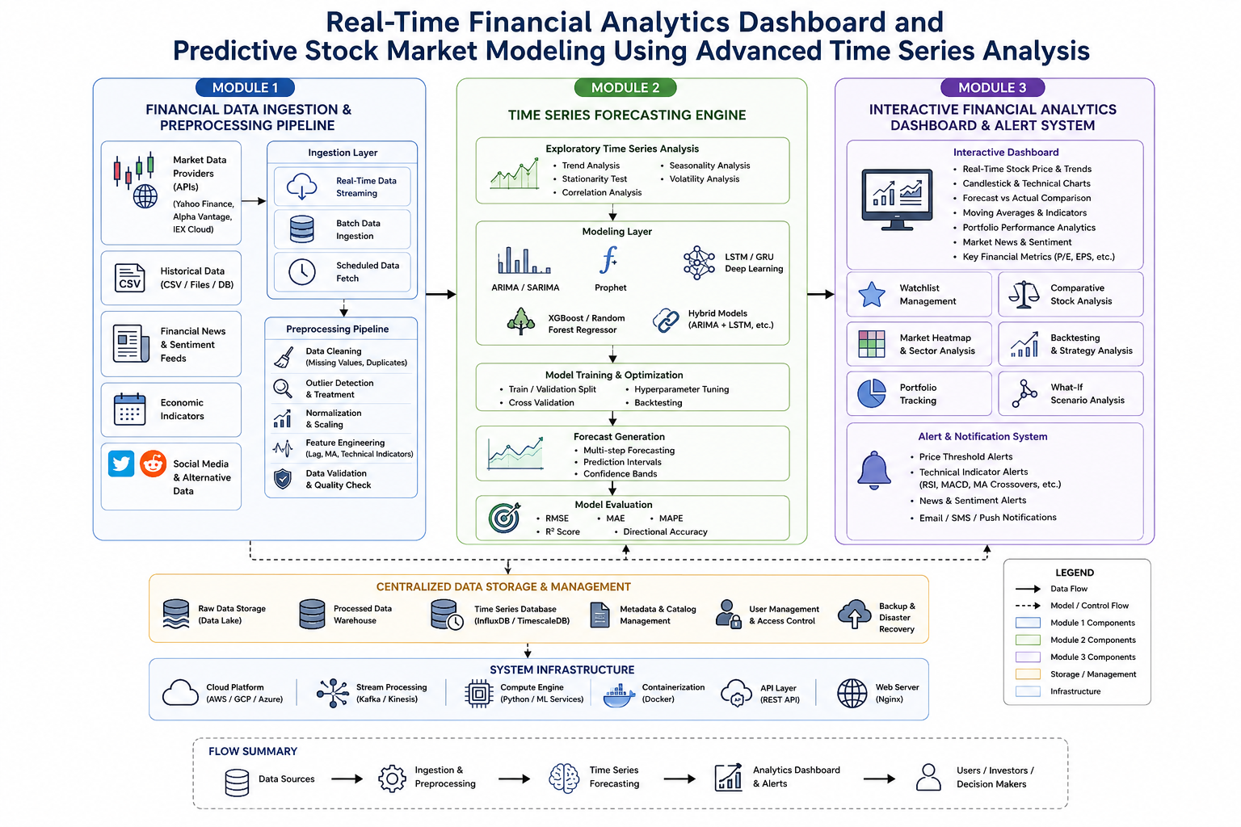
ARCHITECTURE DIAGRAM

Slide 8
Module 1: Financial Data Ingestion & Preprocessing Pipeline
Collect historical and real-time stock market data.
Gather data such as Open, High, Low, Close, and Volume.
Store the collected financial data for further analysis.
Remove missing, duplicate, and incorrect data.
Convert the data into a proper time-series format.
Normalize the data for better model performance.
Generate important features such as Moving Average, RSI, and MACD.
Prepare the final dataset for the forecasting model.
Output: Clean and organized financial data.

Slide 9
Module 2: Time Series Forecasting Engine
Analyze historical stock price movements.
Identify trends, patterns, and seasonal behavior.
Study stock market volatility.
Apply time-series forecasting techniques.
Use models such as ARIMA, Prophet, and LSTM.
Train the models using historical stock data.
Predict future stock prices and market trends.
Compare actual prices with predicted prices.
Evaluate the model using accuracy metrics such as MAE,RMSE, and MAPE.
Output: Future stock price and trend predictions.

Slide 10
Module 3: Interactive Financial Analytics Dashboard & Alert System
Display historical stock prices using interactive charts.
Show predicted stock prices and future trends.
Provide candlestick charts and technical indicators.
Compare the performance of different stocks.
Display important financial metrics.
Track portfolio performance.
Provide simple market and trend analysis.
Generate alerts when stock prices cross a specified level.
Provide notifications for important market changes.
Allow users to view predictions and analytics in one dashboard.
Output: Interactive dashboard with predictions, analytics, and alerts.

Slide 11

FUTURE SCOPE
Integration of Deep Learning Models
Use LSTM, GRU, and Transformer models to improve stock market prediction accuracy.
Real-Time Data Analytics
Incorporate live stock market data feeds for instant analysis and forecasting.
Sentiment Analysis
Analyze news articles and social media trends to better understand market sentiment.
AI-Based Trading Recommendations
Provide intelligent buy, sell, and hold suggestions using machine learning algorithms.
Cloud and Mobile Deployment
Develop cloud-based and mobile platforms for anywhere, anytime access to financial analytics.
Automated Trading Systems
Enable algorithmic trading that can execute transactions automatically based on predictive insights.

Slide 12
CONCLUSION
Developed a smart stock market trend prediction system using Time Series Analysis and Machine Learning techniques.
The proposed system accurately analyzes historical stock market data to forecast future price movements.
Interactive dashboards enable users to visualize stock trends, predictions, and financial performance effectively.
Time Series models improve forecasting accuracy compared to conventional prediction methods.
The system supports investors in making informed, data-driven investment decisions while reducing financial risks.
This project demonstrates the application of Data Science and Predictive Analytics in modern financial market analysis.

Slide 13
REFERNCES
A. A. Ariyo, A. O. Adewumi, and C. K. Ayo, "Stock Price Prediction Using the ARIMA Model," in Proc. 16th Int. Conf. Computer Modelling and Simulation (UKSim), Cambridge, U.K., 2014, pp. 106–112, doi: 10.1109/UKSim.2014.67.
M. B. Taylor and B. Letham, "Forecasting at Scale," PeerJ Computer Science, vol. 3, e3190, 2018.
A. Garlapati, D. R. Krishna, K. Garlapati, N. M. S. Yaswanth, U. Rahul, and G. Narayanan, "Stock Price Prediction Using Facebook Prophet and ARIMA Models," in Proc. 6th Int. Conf. Convergence in Technology (I2CT), Maharashtra, India, 2021, pp. 1–7, doi: 10.1109/I2CT51068.2021.9418057.
R. Xiao, Y. Feng, L. Yan, and Y. Ma, "Predict Stock Prices with ARIMA and LSTM," arXiv preprint arXiv:2209.02407, 2022.
S. Shinde, S. Patil, and R. Kulkarni, "Effective Stock Price Prediction Using Time Series Forecasting," in Proc. 6th Int. Conf. Trends in Electronics and Informatics (ICOEI), 2022, doi: 10.1109/ICOEI53556.2022.9776830.

Slide 14
THANK YOU

